Slide 1
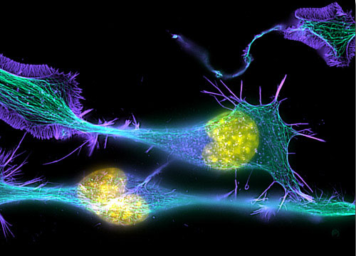
Introduction to
Light Microscopy
(Image: T. Wittman, Scripps)

Slide 2
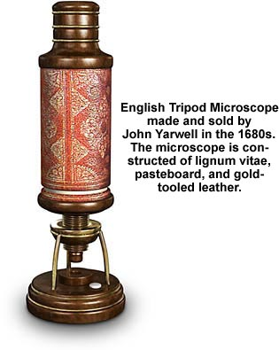
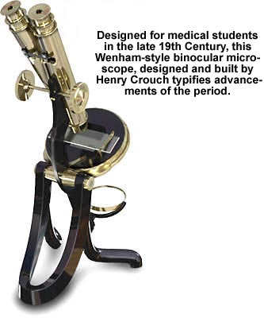
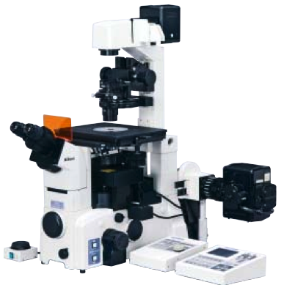
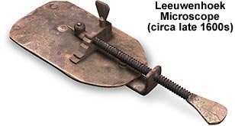
The Light Microscope
Four centuries of history
Vibrant current development
One of the most widely used research tools

Slide 3
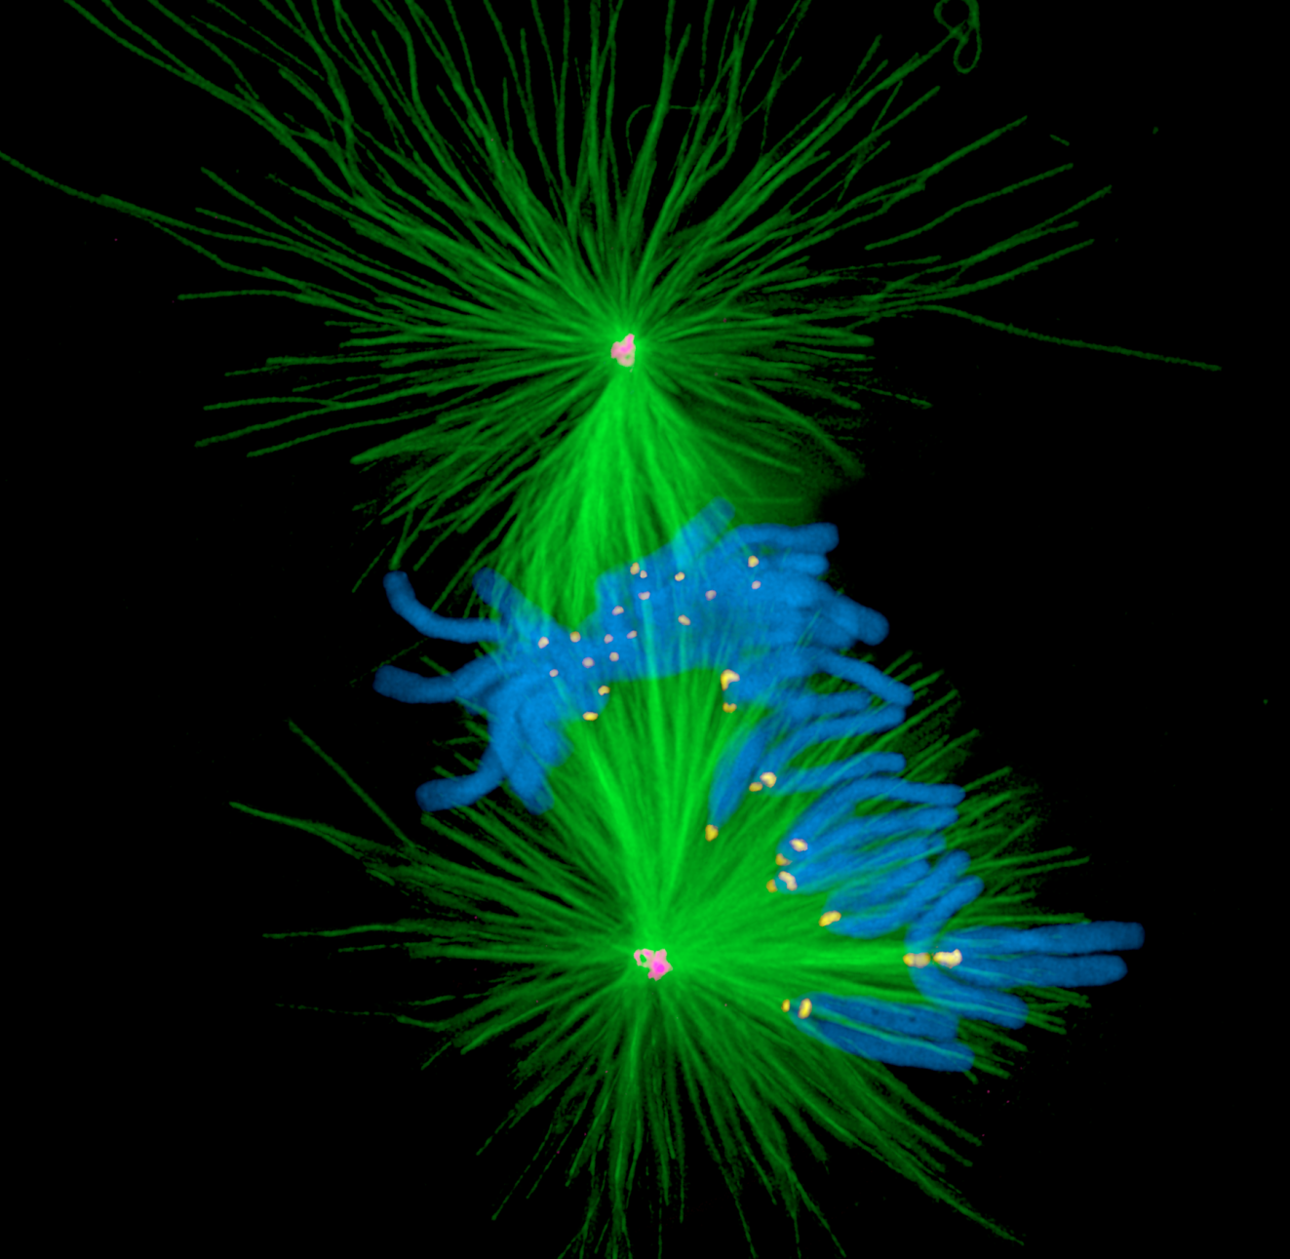
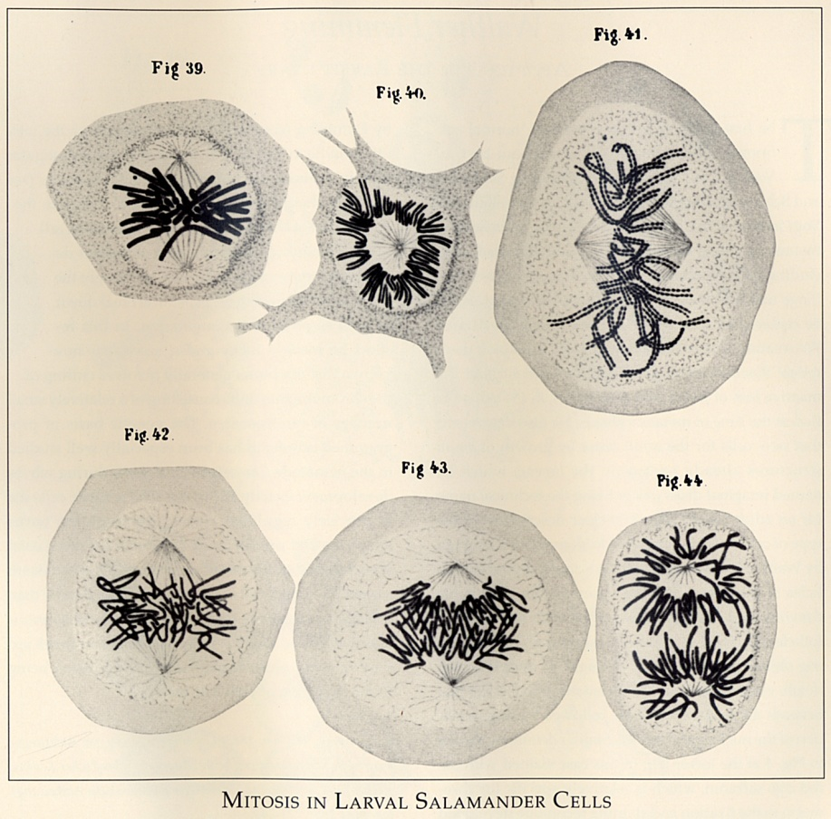
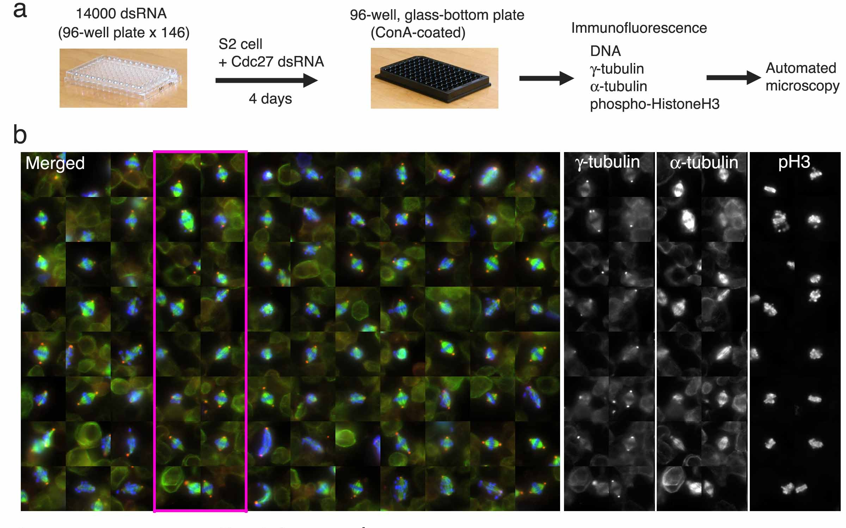
A. Khodjakov et al.

Slide 4
Major Imaging Functions of the Microscope
Magnify
Resolve features
Generate Contrast
Capture and Display Images

Slide 5
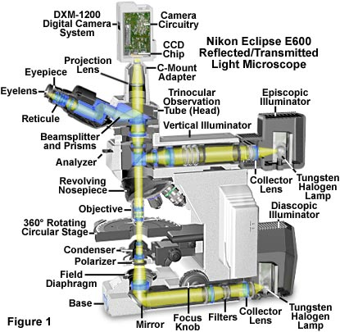
An Upright Epifluorescence Microscope

Slide 6
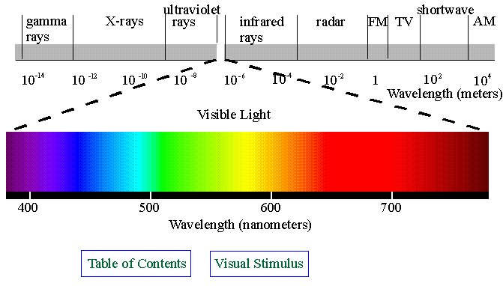
Electromagnetic Waves

Slide 7
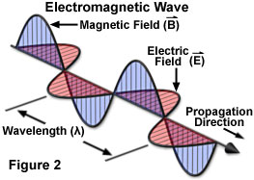
Waves vs. Photons vs. Rays
Quantum wave-particle duality
Rays: photon trajectories
Rays: propagation direction of waves

Slide 8
Rays are perpendicular to wavefronts

Slide 9
Light travels more slowly in matter
The speed ratio is the Index of Refraction, n
v = c/n
n = 1
n > 1
n = 1

Slide 10
Refractive Index Examples
Vacuum 1
Air 1.0003
Water 1.333
Cytoplasm 1.35–1.38 ?
Glycerol 1.475 (anhydrous)
Immersion oil 1.515
Fused silica 1.46
Optical glasses 1.5–1.9
Diamond 2.417
Depends on wavelength and temperature

Slide 11
Refraction by an Interface
θ_{r}
Incident wave
Reflected wave
θ₁
Refractive index n₁ = 1
Speed = c
λ
Refractive index n₂
Speed = c/n
θ₂
Refracted wave
λ/n
⇒ Snell’s law:
Mirror law:
n₁ Sin(θ₁) = n₂ Sin(θ₂)
θ_{r} = θ₁

Slide 12
Which Direction?
n₁
n₂ > n₁
Refraction goes
towards the normal
in the higher-index medium

Slide 13
Lenses work by refraction
Incident light
focus
Focal length f

Slide 14
Ray Tracing Rules of Thumb (for thin ideal lenses)
Parallel rays converge
at the focal plane
Rays that cross in the focal plane
end up parallel
f
f
Rays through the lens center are unaffected

Slide 15
Imaging
f
Image
Object
d₁
d₂
L₁
L₂
The lens law:
Magnification:

Slide 16
Real and virtual images
Real
image
Virtual
image
f>0
f>0
Object
Object
L₁>f
L₁<f
f<0
f<0
Real
image
Object
Virtual
image
Virtual
object
The same lens law applies: Negative lenses have negative f
Virtual objects or images have negative values of L₁ or L₂

Slide 17
Finite vs. Infinite Conjugate Imaging
Finite conjugate imaging (older objectives)
Image
f₀
Object
>f₀
f₀
Infinite conjugate imaging (modern objectives).
Image at infinity
f₁
⇒ Need a tube lens
Image
f₀
Object
f₀
f₀
(uncritical)
f₁
Magnification:

Slide 18
Back focal plane
Back focal plane
f₀
Object
f₀
f₀
Rays that leave the object with the same angle
meet in the objective’s back focal plane

Slide 19
The Compound Microscope
Exit pupil
Eyepiece
Primary or intermediate
image plane
Tube lens
Back focal plane (pupil)
Objective
Sample
Object plane

Slide 20
The Compound Microscope
Final image
Eye
Exit pupil
Eyepiece
Intermediate image plane
Tube lens
Back focal plane (pupil)
Objective
Sample
Object plane

Slide 21
The Compound Microscope
Final image
Eye
Exit pupil
Eyepiece
Intermediate image plane
Tube lens
Back focal plane (pupil)
Objective
Sample
Object plane

Slide 22
The Compound Microscope
Final image
Eye
Exit pupil
Eyepiece
Intermediate image plane
Tube lens
Back focal plane (pupil)
Objective
Sample
Object plane

Slide 23
The Compound Microscope
Final image
Eye
Exit pupil
Eyepiece
Intermediate image plane
Tube lens
Back focal plane (pupil)
Objective
Sample
Object plane

Slide 24
The Compound Microscope
Camera
Final image
Secondary pupil
Projection Eyepiece
Intermediate image plane
Tube lens
Back focal plane (pupil)
Objective
Sample
Object plane

Slide 25
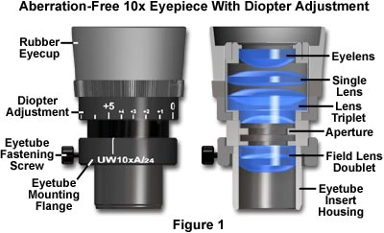
Eyepieces (Oculars)
Features
Magnification (10x typical)
“High eye point” (exit pupil high
enough to allow eyeglasses)
Diopter adjust (at least one
must have this)
Reticle or fitting for one
Eye cups

Slide 26
Trans-illumination Microscope
Camera
Final image plane
Secondary pupil plane
Projection Eyepiece
Imaging
path
Intermediate image plane
Tube lens
Back focal plane (pupil)
Objective
Sample
Object plane
Condenser lens
The aperture iris
controls the range of
illumination angles
Aperture iris
(pupil plane)
Illumination
path
Field lens
Field iris
(image plane)
The field iris
controls the
illuminated
field of view
Collector
Light source
(pupil plane)

Slide 27
Köhler Illumination
Critical Illumination
Sample
Object plane
Aperture iris
(pupil plane)
Field iris
(image plane)
Light source
(pupil plane)
Each light source point produces a parallel beam of light at the sample
Uniform light intensity at the sample even if the light source is “ugly” (e.g. a filament)
The source is imaged onto the sample
Usable only if the light source is perfectly uniform

Slide 28
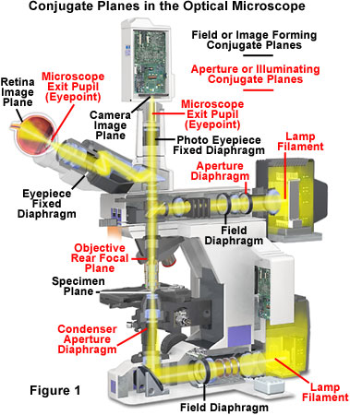
Conjugate Planes in A Research Microscope

Slide 29
How view the pupil planes?
Two ways:
“Eyepiece telescope”
“Bertrand lens”

Slide 30
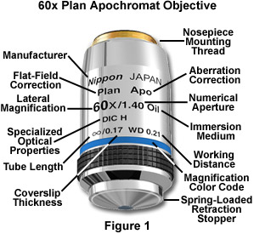
By far the most important part: the Objective Lens
Each major manufacturer sells 20-30 different categories of objectives.
What are the important distinctions?

Slide 31
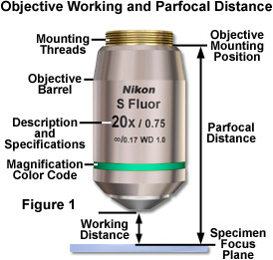
Working Distance
In general, high NA lenses have short working distances
However, extra-long working distance objectives do exist
Some examples:
10x/0.3 WD = 15.2mm
20x/0.75 WD = 1.0mm
100x/1.4 WD = 0.13mm

Slide 32
The focal length of a lens depends on the refractive index…
Refractive index n
Focal length f
f ∝ 1/(n-1)

Slide 33
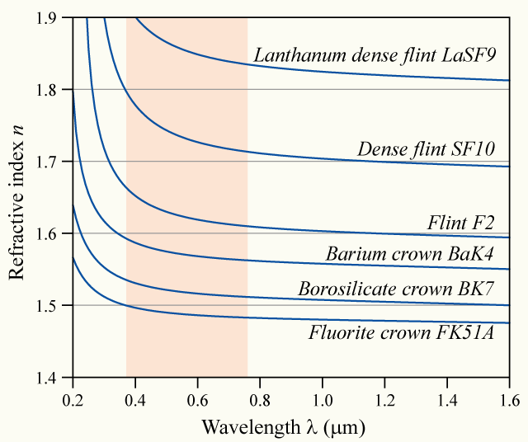
… and the refractive index depends on the wavelength (“dispersion”)
Glass
types

Slide 34
⇒ Chromatic aberration
Different colors get focused to different planes
Not good…

Slide 35
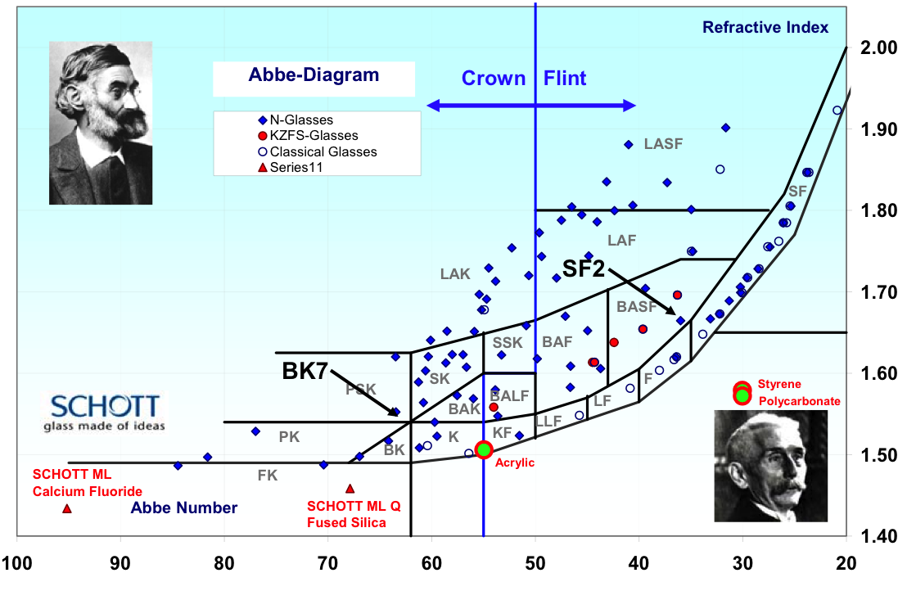

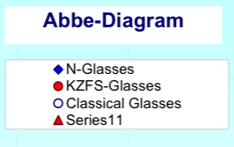

Dispersion vs. refractive index of different glass types
Refractive
index
Abbe dispersion number
(Higher dispersion→)

Slide 36
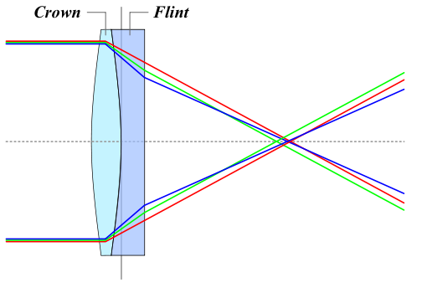
Achromatic Lenses
Use a weak negative flint glass element
to compensate the dispersion of a
positive crown glass element

Slide 37
Achromats and Apochromats
Focal length error
Wavelength
Apochromat (≥3 glass types)
Achromat (2 glass types)
Simple lens

Slide 38
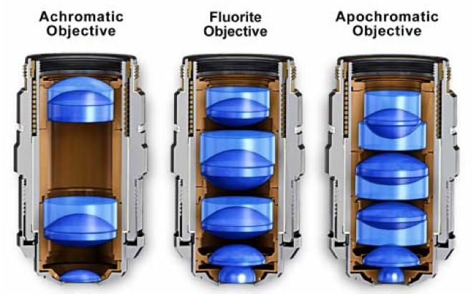
Correction classes of objectives
Achromat (cheap)
Fluor “semi-apo” (good correction, high UV transmission)
Apochromat (best correction)
Correction for other (i.e. monochromatic) aberrations also improves in the same order

Slide 39
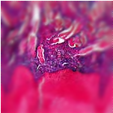
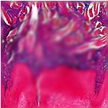
Curvature of Field
Focal plane
Focal plane Focal surface
Tube lens
objective
sample
Focal
surface

Slide 40
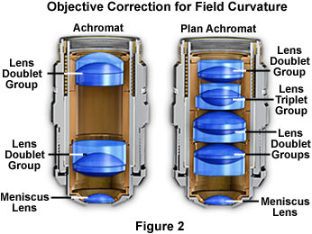
Plan objectives
Corrected for field curvature
More complex design
Needed for most photomicrography
Plan-Apochromats have the highest performance
(and highest complexity and price)

Slide 41
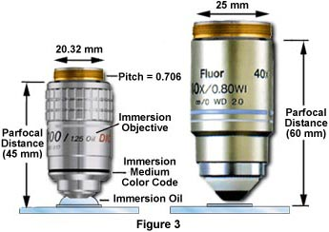
Putting one brand of objectives onto another brand of microscope?
Pitch = 0.75
Usually a bad idea:
May not even fit
May get different magnification than
is printed on the objective
Incompatible ways of
correcting lateral chromatic
aberration (LCA)
⇒ mixing brands can produce severe LCA
Tube lens focal length
Nikon 200
Leica 200
Olympus 180
Zeiss 165
LCA correction:
In objective In tube lens
Nikon Leica Olympus Zeiss

Slide 42
Lateral chromatic aberration (= LCA, lateral color, chromatic difference of magnification)
= Different magnification for different colors
Object
Image

Slide 43
Interference
In phase
constructive interference
=
+
Opposite phase
destructive interference
=
+

Slide 44
Diffraction by a periodic structure (grating)

Slide 45
Diffraction by a periodic structure (grating)
θ
θ
d
d Sin(θ)
In phase if:
d Sin(θ) = m λ
for some integer m

Slide 46
Diffraction by an aperture
drawn as waves
Light spreads to new angles
Larger aperture
⇔
weaker diffraction

Slide 47
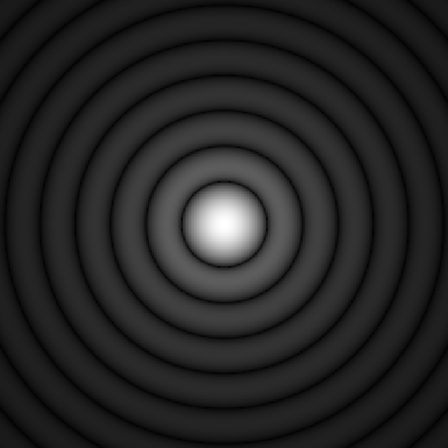
Diffraction by an aperture
drawn as rays
The pure, “far-field”
diffraction pattern
is formed at ∞ distance…
Tube lens
…or can be formed
at a finite distance
by a lens…
Intermediate
image
…as happens in a microscope
Objective pupil

Slide 48
The Airy Pattern
= the far-field diffraction pattern from a round aperture
Height of
first ring
≈ 1.75%
“Airy disk” diameter
d = 2.44 λ f/d
(for small angles d/f)
d
f

Slide 49
Aperture and Resolution
Diffraction spot
on image plane
= Point Spread Function
Intermediate image plane
Objective
Tube lens
Sample
Back focal plane aperture

Slide 50
Aperture and Resolution
Diffraction spot
on image plane
= Point Spread Function
Intermediate image plane
Objective
Tube lens
Sample
Back focal plane aperture

Slide 51
Aperture and Resolution
Diffraction spot
on image plane
= Point Spread Function
Intermediate image plane
Objective
Tube lens
Sample
Back focal plane aperture

Slide 52
Aperture and Resolution
Diffraction spot
on image plane
(resolution)
Intermediate image plane
Objective
Tube lens
Sample
α
Back focal plane aperture
Image resolution improves with aperture size
Numerical Aperture (NA)
NA = n sin(α)
= light gathering angle
n = refractive index of sample
where:

Slide 53

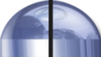
Numerical Aperture
100X / 0.95 NA
α = 71.8°
4X / 0.20 NA
α = 11.5°

Slide 54
Numerical Aperture
Compare:
Numerical Aperture:
NA = n sin(α)
Snell’s law:
n₁ sin(θ₁) = n₂ sin(θ₂)
θ₁
α
θ₂
n sin(θ) doesn’t change at horizontal interfaces
sin(anything) ≤ 1
NA cannot exceed
the lowest n between the
sample and the objective lens
Cover
glass
Sample

Slide 55
Numerical Aperture
Compare:
Numerical Aperture:
NA = n sin(α)
Snell’s law:
n₁ sin(θ₁) = n₂ sin(θ₂)
θ₁
α
θ₂
n sin(θ) doesn’t change at horizontal interfaces
sin(anything) ≤ 1
NA cannot exceed
the lowest n between the
sample and the objective lens
NA >1 requires fluid immersion
Immersion fluid
Cover
glass
Sample

Slide 56
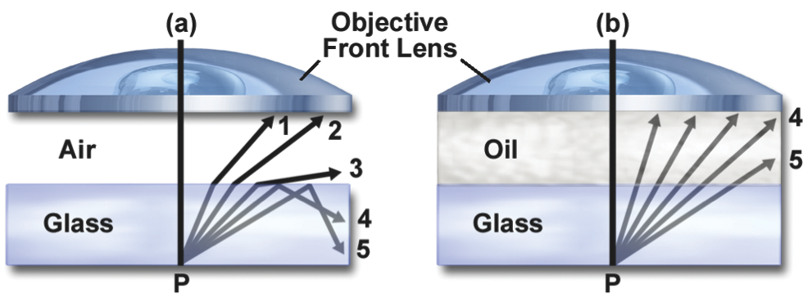
Immersion Objectives
NA can approach
the index of the
immersion fluid
Oil immersion:
n ≈ 1.515
max NA ≈ 1.4 (1.45–1.49 for TIRF)
Glycerol immersion:
n ≈ 1.45 (85%)
max NA ≈ 1.35 (Leica)
Water immersion:
n ≈ 1.33
max NA ≈ 1.2

Slide 57
Objective Types
Field flatness
Plan or not
Phase rings for phase contrast
Positive or negative
Diameter of ring (number)
Special Properties
Strain free for Polarization or DIC
Features
Correction collar for spherical aberration
Iris
Spring-loaded front end
Lockable front end
Basic properties
Magnification
Numerical Aperture (NA)
Infinite or finite conjugate
Cover slip thickness if any
Immersion fluid if any
Correction class
Achromat
Fluor
Apochromat

Slide 58
Further reading
www.microscopyu.com
micro.magnet.fsu.edu
Douglas B. Murphy “Fundamentals of Light Microscopy and Electronic Imaging”
James Pawley, Ed. “Handbook of Biological Confocal Microscopy, 3rd ed.”
Acknowledgements
Ron Vale / Mats Gustafsson

